Slide 1
Measures of Central Tendency (1)
Md. Ismail Hossain Riday

Slide 2
Descriptive measures
In previous chapter, we discussed how a raw data set can be organized and summarized by tables and graphs.
Another method of summarizing data set precisely is to compute number (a single number).
Number that can be describe data sets are called descriptive measures

Slide 3
Descriptive measures
Four types of descriptive measure
Measures of central tendency
Measures of Location
Measures of Dispersion
Shape of the distribution

Slide 4
Measures of Central Tendency
It is a summary measure
Attempts to describe the whole data set with a single value
Represents the center of the distribution

Slide 5
Types of C.T.
Mean
Median
Mode

Slide 6
Types of mean
Arithmetic mean
Geometric mean
Harmonic mean

Slide 7
Arithmetic Mean
It is simply sum of the observations divided by the total number of observations

Slide 8
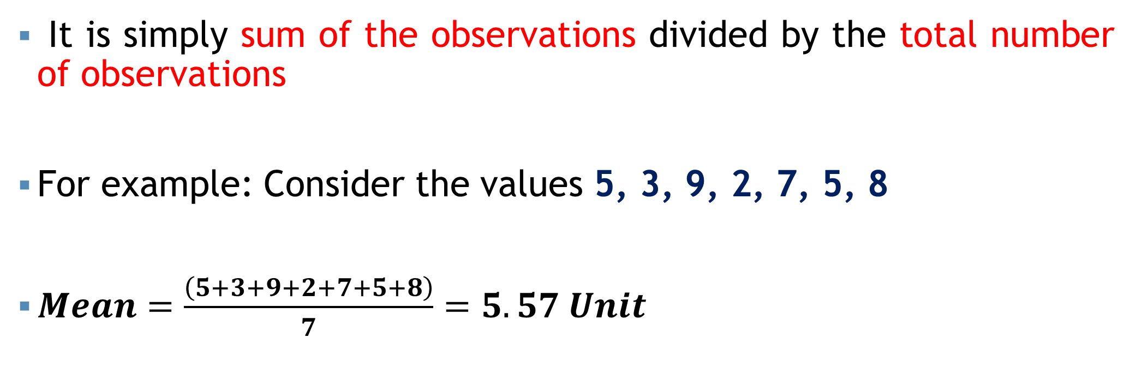
Arithmetic Mean
It is simply sum of the observations divided by the total number of observations
For example: Consider the values 5, 3, 9, 2, 7, 5, 8
$Mean=\frac{\left(5+3+9+2+7+5+8\right)}{7}=5.57 Unit$

Slide 9
Formula: AM
Ungrouped Data | Grouped Data

Slide 10

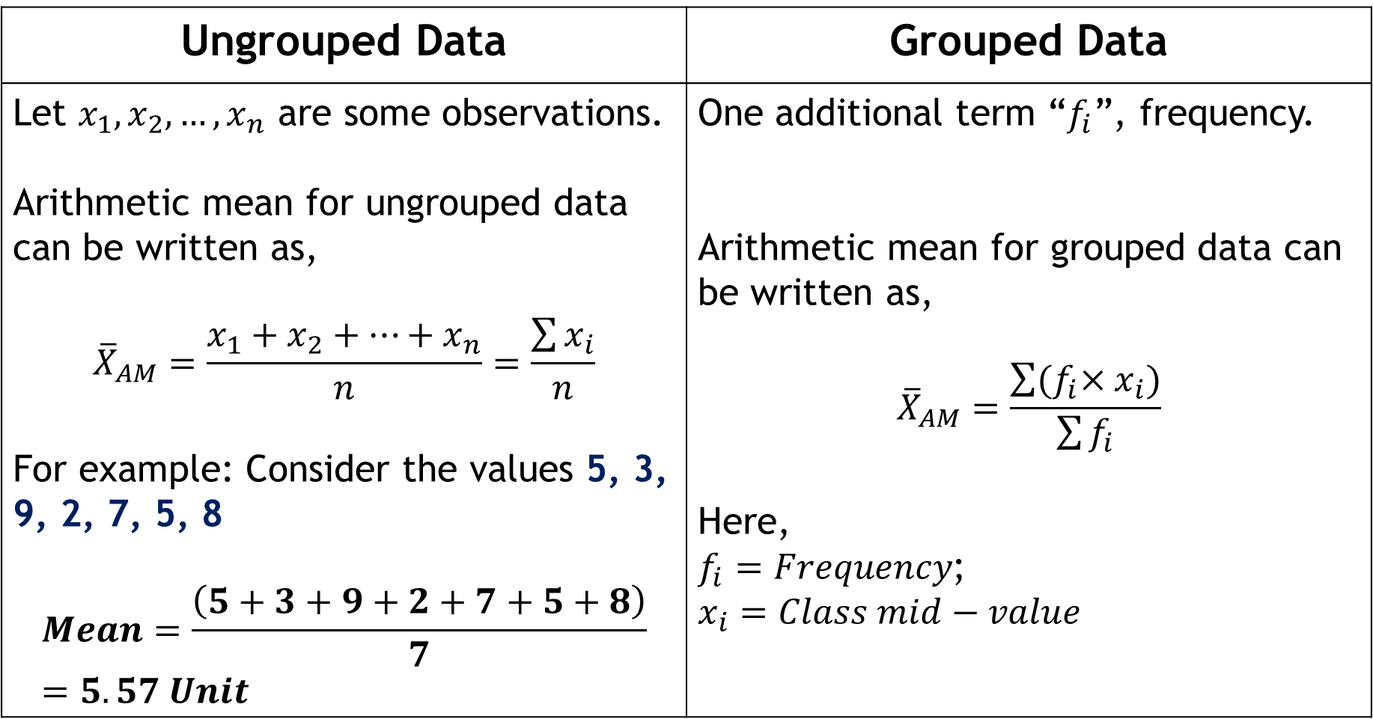

Formula: AM
$$\frac{\sum{x_{i}}}{n}$$
Ungrouped Data | Grouped Data
Let $x_{1}, x_{2},…, x_{n}$ are some observations. Arithmetic mean for ungrouped data can be written as, $${\overline{X}}_{AM}=\frac{x_{1}+x_{2}+…+x_{n}}{n}=\frac{\sum{x_{i}}}{n}$$ For example: Consider the values 5, 3, 9, 2, 7, 5, 8 $$Mean=\frac{\left(5+3+9+2+7+5+8\right)}{7}=5.57 Unit$$ | One additional term “$f_{i}$”, frequency. Arithmetic mean for grouped data can be written as, $${\overline{X}}_{AM}=\frac{\sum{{(f}_{i}×x_{i})}}{\sum{f_{i}}}$$ Here, $f_{i}=Frequency$; $x_{i}=Class mid−value$
$$\frac{\sum{{{(f}_{i}x}_{i})}}{∑f_{i}}$$

Slide 11
Ungroup data: AM
Page 57 (7 to 10)
The Sun Times reported the following car prices for a sample of cars sold in Phoenix, AZ, during the previous month (in $1000s): 25, 30, 22, 28, 35, 40, 18, 26, 32, 29. Calculate and interpret the sample mean.
The sample mean of 180 observations is 7. But on comparing the original data, it was found that an observation 12 was misreported as 21 in the computation. Compute the correct mean.
Ans: 28.5. Average car price is 28500$

Slide 12
Group data: AM
Class | Frequency
5-9 | 4
9-13 | 3
13-17 | 3
17-21 | 3

Slide 13
Group data: AM
Class | Frequency
5-9 | 4
9-13 | 3
13-17 | 3
17-21 | 3
Calculate mean from this table…

Slide 14
Group data: AM
Class | Frequency
5-9 | 4
9-13 | 3
13-17 | 3
17-21 | 3
Calculate mean or arithmetic mean from this table…

Slide 15
Group data: AM
Class | Frequency
5-9 | 4
9-13 | 3
13-17 | 3
17-21 | 3
Calculate mean or arithmetic mean or average from this table…

Slide 16
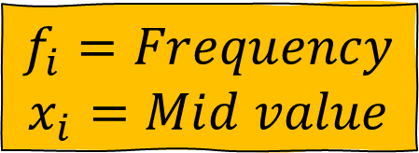
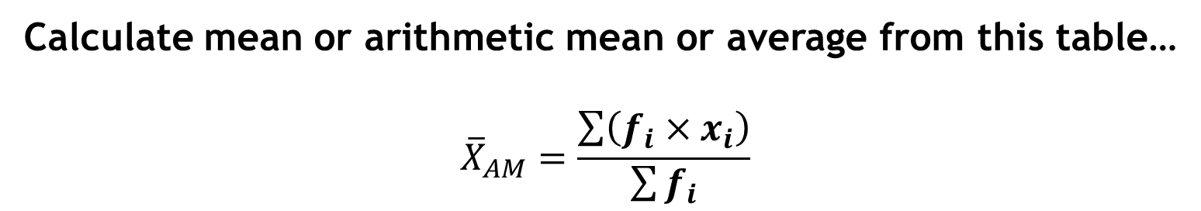
Group data: AM
Class | Frequency
5-9 | 4
9-13 | 3
13-17 | 3
17-21 | 3
$$f_{i}=Frequency$$
$$x_{i}=Mid value$$
Calculate mean or arithmetic mean or average from this table…
$${\overline{X}}_{AM}=\frac{\sum{\left(f_{i}×x_{i}\right)}}{\sum{f_{i}}}$$

Slide 17
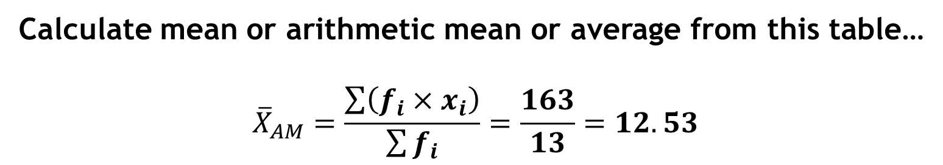
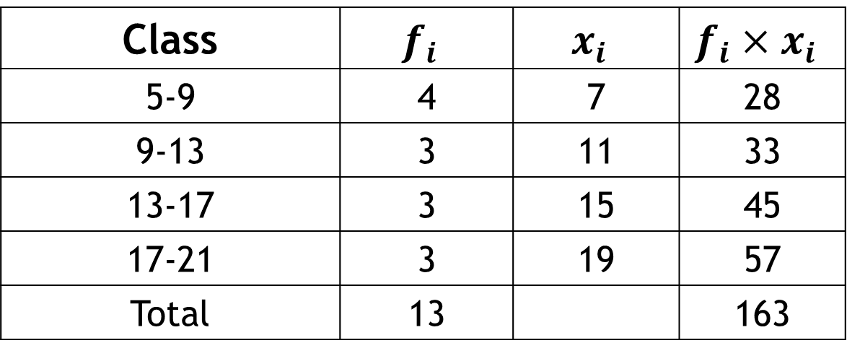
Group data: AM
Class | $$f_{i}$$ | $$x_{i}$$ | $$f_{i}×x_{i}$$
5-9 | 4 | 7 | 28
9-13 | 3 | 11 | 33
13-17 | 3 | 15 | 45
17-21 | 3 | 19 | 57
Total | 13 |  | 163
Calculate mean or arithmetic mean or average from this table…
$${\overline{X}}_{AM}=\frac{\sum{\left(f_{i}×x_{i}\right)}}{\sum{f_{i}}}=\frac{163}{13}=12.53$$

Slide 18
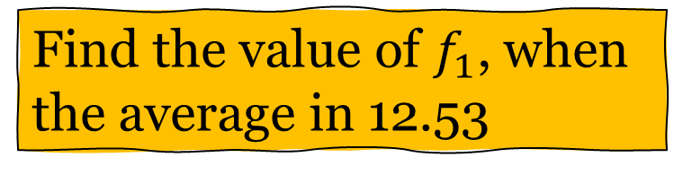
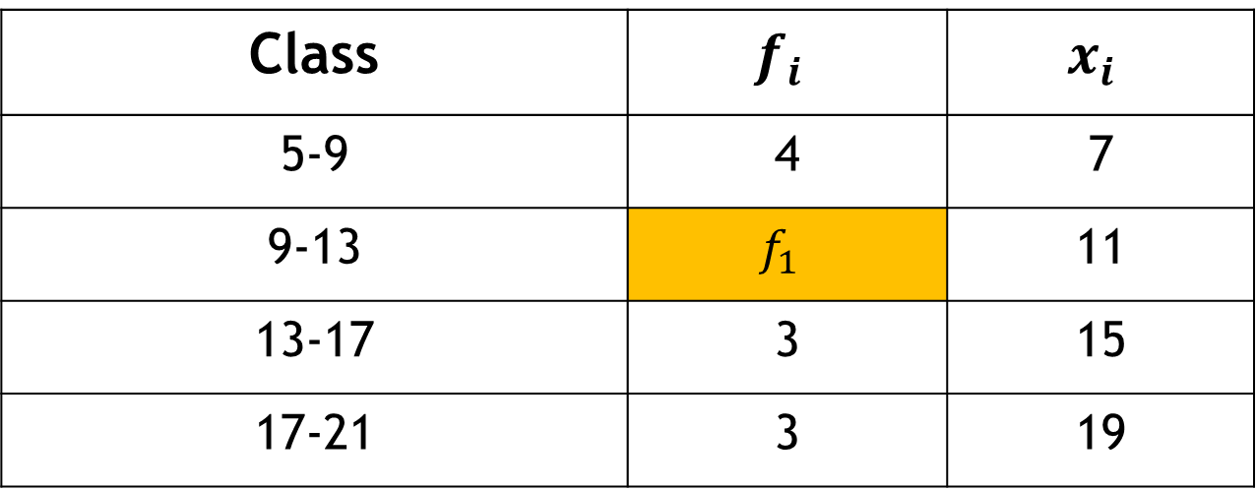
Group data: AM
Class | $$f_{i}$$ | $$x_{i}$$
5-9 | 4 | 7
9-13 | $$f_{1}$$ | 11
13-17 | 3 | 15
17-21 | 3 | 19
Find the value of $f_{1}$, when the average in 12.53

Slide 19
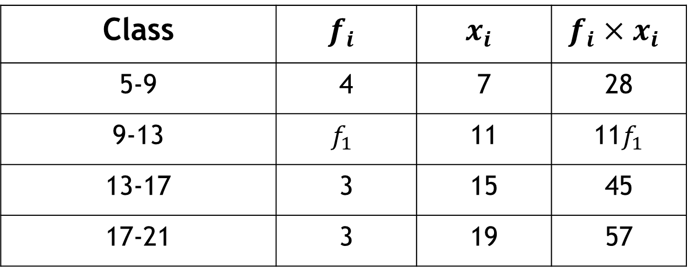
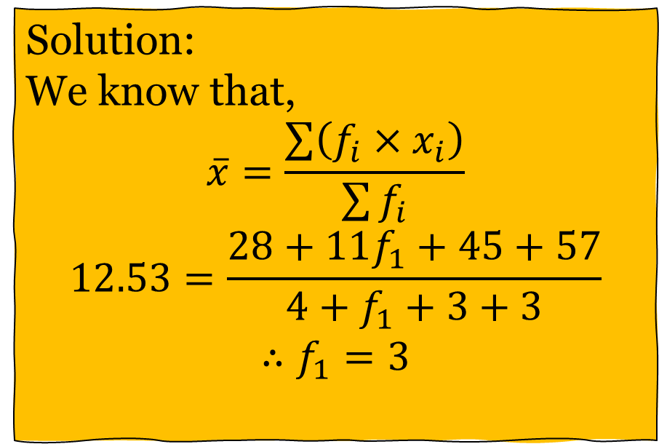
Group data: AM
Class | $$f_{i}$$ | $$x_{i}$$ | $$f_{i}×x_{i}$$
5-9 | 4 | 7 | 28
9-13 | $$f_{1}$$ | 11 | 11$f_{1}$
13-17 | 3 | 15 | 45
17-21 | 3 | 19 | 57
Solution:
We know that,
$$\overline{x}=\frac{\sum{\left(f_{i}×x_{i}\right)}}{\sum{f_{i}}}$$
$$12.53=\frac{28+11f_{1}+45+57}{4+f_{1}+3+3}$$
$$∴f_{1}=3$$
Find the value of $f_{1}$, when the average in 12.53

Slide 20
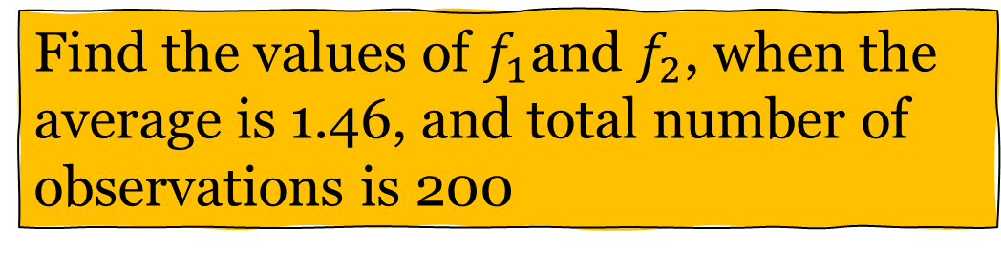
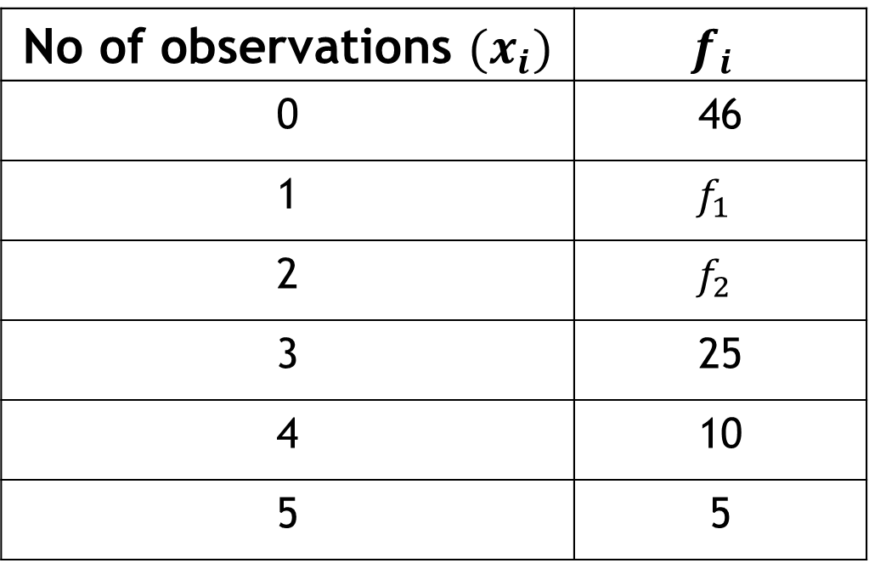
Self Practice
No of observations $(x_{i})$ | $$f_{i}$$
0 | 46
1 | $$f_{1}$$
2 | $$f_{2}$$
3 | 25
4 | 10
5 | 5
Find the values of $f_{1}$and $f_{2}$, when the average is 1.46, and total number of observations is 200

Slide 21
Geometric Mean
It is useful when dealing with data that exhibits
Exponential growth, or
Growth over the year/ change over a period of times, or
Geometric progression

Slide 22
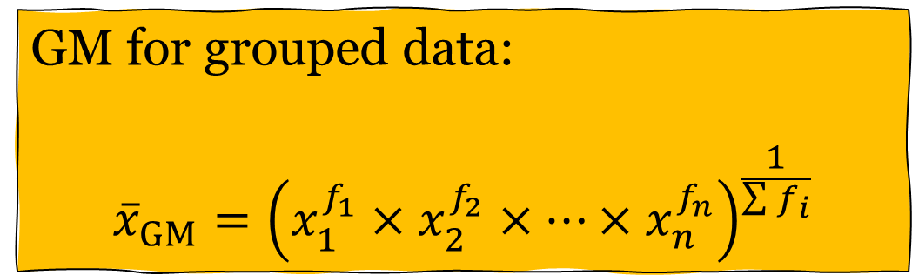
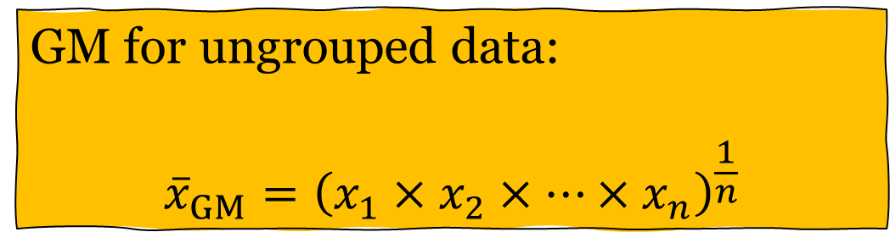
Geometric Mean
GM for ungrouped data:
$${\overline{x}}_{GM}={\left(x_{1}×x_{2}×…×x_{n}\right)}^{\frac{1}{n}}$$
GM for grouped data:
$${\overline{x}}_{GM}={\left(x_{1}^{f_{1}}×x_{2}^{f_{2}}×…×x_{n}^{f_{n}}\right)}^{\frac{1}{\sum{f_{i}}}}$$

Slide 23

Geometric Mean
For example: 5, 3, 9, 2, 7, 5, 8
${\overline{X}}_{GM}={\left(5×3×9×2×7×5×8\right)}^{\frac{1}{7}}=4.98$

Slide 24
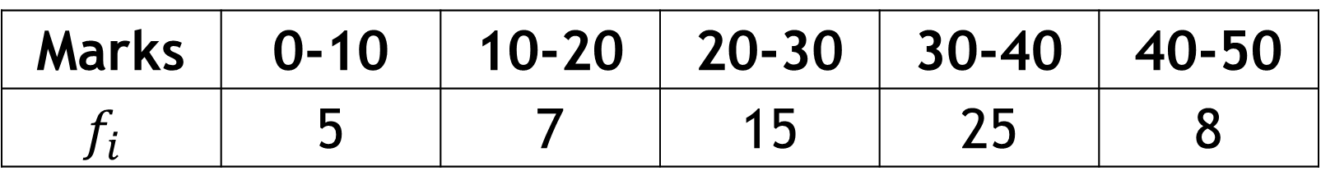
Geometric Mean
Find the geometric mean for the following distribution:
Marks | 0-10 | 10-20 | 20-30 | 30-40 | 40-50
$$f_{i}$$ | 5 | 7 | 15 | 25 | 8

Slide 25

Geometric Mean
If $x_{i}$ are the percent value (rate) for a given time t,
$${Average growth rate=\left\{\left(1+r_{1}\right)×\left(1+r_{2}\right)×…×\left(1+r_{n}\right)\right\}}^{\frac{1}{n}}−1$$
$${Average depreciation rate=\left\{\left(1−r_{1}\right)×\left(1−r_{2}\right)×…×\left(1−r_{n}\right)\right\}}^{\frac{1}{n}}−1$$

Slide 26
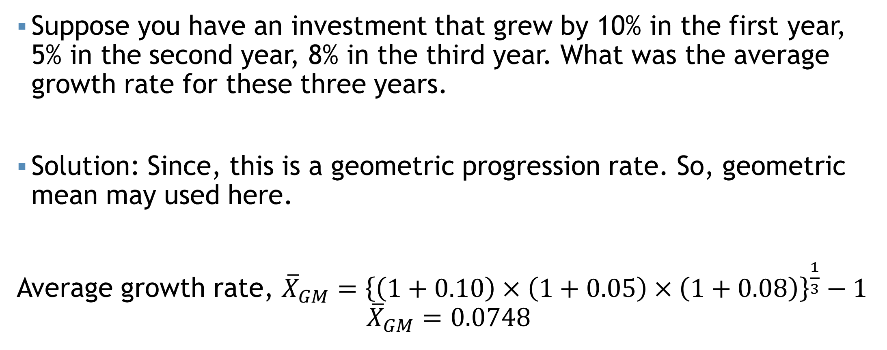
Geometric Mean
Suppose you have an investment that grew by 10% in the first year, 5% in the second year, 8% in the third year. What was the average growth rate for these three years.
Solution: Since, this is a geometric progression rate. So, geometric mean may used here.
Average growth rate, ${\overline{X}}_{GM}={\left\{\left(1+0.10\right)×\left(1+0.05\right)×\left(1+0.08\right)\right\}}^{\frac{1}{3}}−1$
$${\overline{X}}_{GM}=0.0748$$
Comment: Thus, the average growth rate is 7.48%

Slide 27
Geometric Mean
Let’s consider an assets that depreciated by 15% in the first year, 8% in the second year, and 12% in the third year. What was the average depreciation rate over these three years.
$${Average depreciation rate=\left\{\left(1−r_{1}\right)×\left(1−r_{2}\right)×…×\left(1−r_{n}\right)\right\}}^{\frac{1}{n}}−1$$

Slide 28
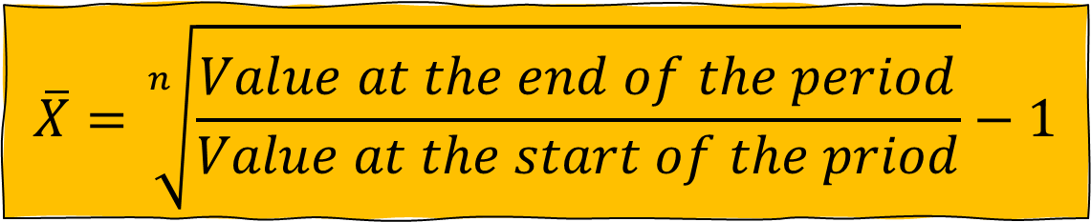
Geometric Mean
Page 68 (27 to 32)
An economy grows at the rate of 2% in the first year, 2.5% in the second year, 4% in the fourth year, and 10% in the fifth year. Identify the rate of third year where the average growth rate in 4.26%.
During the decade of the 1990s, and into the 2000s, Las Vegas, Nevada, was one of the fastest-growing cities in the United States. The population increased from 258,295 in 1990 to 613,599 in 2014. This is an increase of 355,304 people, or a 137.56% increase over the period. The population has more than doubled. What is the average annual percent increase?
Ans: 2.5% (Approximately)
$$\overline{X}=\sqrt[n]{\frac{Value at the end of the period}{Value at the start of the priod}}−1$$

Slide 29


Harmonic Mean
It is necessary to compute the average of some variables such as the average speed, average velocity, and so on.
HM for ungrouped data:
$$\overline{X}=\frac{n}{\frac{1}{x_{1}}+\frac{1}{x_{2}}+…+\frac{1}{x_{n}}}$$
HM for grouped data:
$$\overline{X}=\frac{\sum{f_{i}}}{\frac{f_{1}}{x_{1}}+\frac{f_{2}}{x_{2}}+…+\frac{f_{n}}{x_{n}}}$$

Slide 30

Harmonic Mean
For example: 5, 3, 9, 2, 7, 5, 8
${\overline{X}}_{HM}=\frac{7}{\frac{1}{5}+\frac{1}{3}+…+\frac{1}{8}}=(???)$

Slide 31
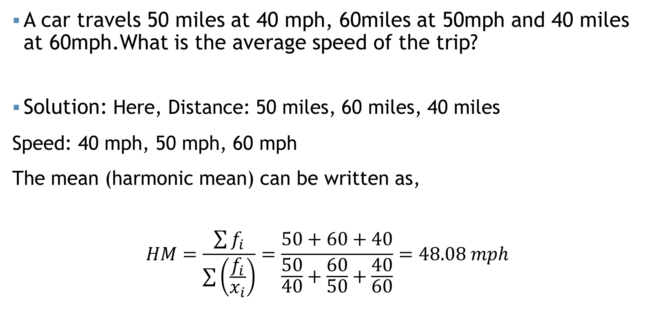
Harmonic Mean
A car travels 50 miles at 40 mph, 60miles at 50mph and 40 miles at 60mph.What is the average speed of the trip?
Solution: Here, Distance: 50 miles, 60 miles, 40 miles
Speed: 40 mph, 50 mph, 60 mph
The mean (harmonic mean) can be written as,
$$HM=\frac{\sum{f_{i}}}{\sum{\left(\frac{f_{i}}{x_{i}}\right)}}=\frac{50+60+40}{\frac{50}{40}+\frac{60}{50}+\frac{40}{60}}=48.08 mph$$

Slide 32
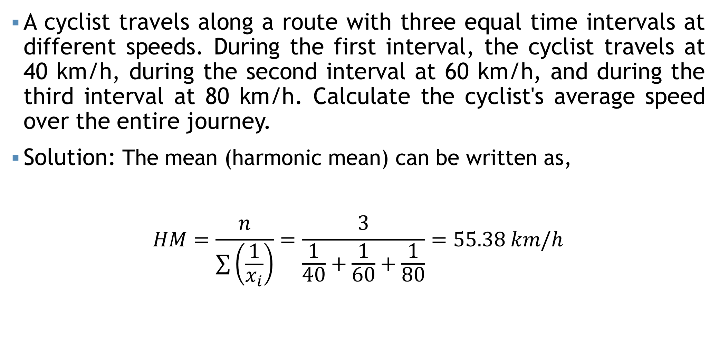
Harmonic Mean
A cyclist travels along a route with three equal time intervals at different speeds. During the first interval, the cyclist travels at 40 km/h, during the second interval at 60 km/h, and during the third interval at 80 km/h. Calculate the cyclist's average speed over the entire journey.
Solution: The mean (harmonic mean) can be written as,
$$HM=\frac{n}{\sum{\left(\frac{1}{x_{i}}\right)}}=\frac{3}{\frac{1}{40}+\frac{1}{60}+\frac{1}{80}}=55.38 km/h$$

Slide 33
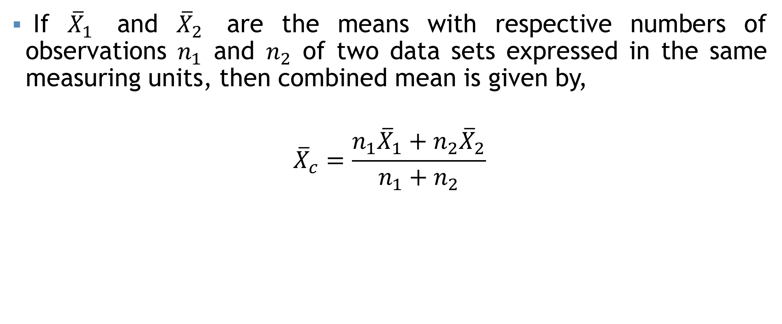
Combined Mean
If ${\overline{X}}_{1}$ and ${\overline{X}}_{2}$ are the means with respective numbers of observations $n_{1}$ and $n_{2}$ of two data sets expressed in the same measuring units, then combined mean is given by,
$${\overline{X}}_{c}=\frac{n_{1}{\overline{X}}_{1}+n_{2}{\overline{X}}_{2}}{n_{1}+n_{2}}$$

Slide 34
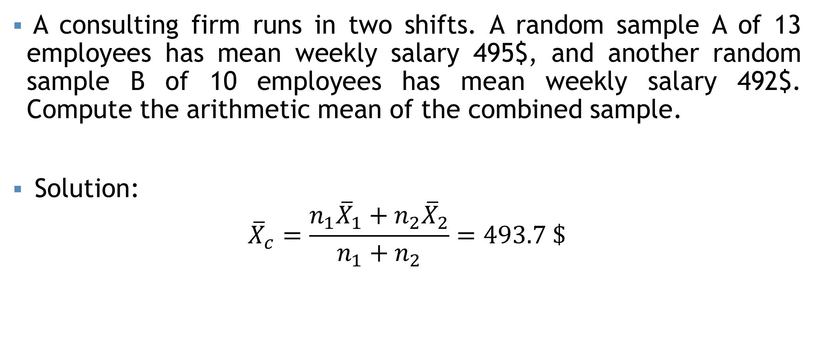
Combined Mean
A consulting firm runs in two shifts. A random sample A of 13 employees has mean weekly salary 495$, and another random sample B of 10 employees has mean weekly salary 492$. Compute the arithmetic mean of the combined sample.
Solution:
$${\overline{X}}_{c}=\frac{n_{1}{\overline{X}}_{1}+n_{2}{\overline{X}}_{2}}{n_{1}+n_{2}}=493.7 \$$$

Slide 35

Some points…
$AM≥GM≥HM$
$GM=\sqrt{AM×HM}$

Slide 36
Weighted mean
The weighted mean is a special case of the arithmetic mean. It occurs when there are several observations of the same value.
To explain- Suppose the Shumi’s Hot Cake offers three different kinds of burger packages small, medium and large for Tk. 100, Tk. 125 and Tk. 150. Of the last 10 burgers sold 3 were small, 4 were medium and 3 were large. To find the mean price of the last 10 burger packages sold we can calculate using the usual formula of the arithmetic mean as follows
$${\overline{X}}_{AM}=\frac{\left(100+100+100+125+125+125+125+150+150+150\right)}{10}=125$$

Slide 37
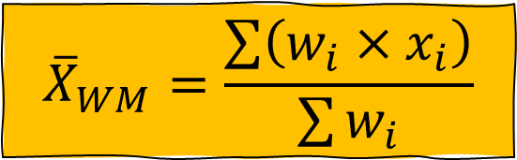
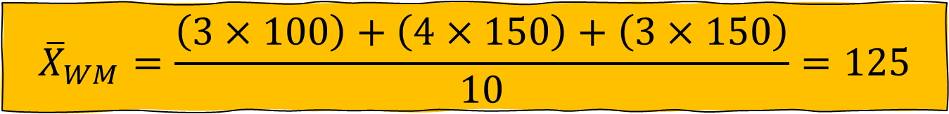
Weighted mean
$${\overline{X}}_{WM}=\frac{\sum{\left(w_{i}×x_{i}\right)}}{\sum{w_{i}}}$$
An easier way to find the mean selling price is to determine the weighted mean.
$${\overline{X}}_{WM}=\frac{\left(3×100\right)+\left(4×150\right)+\left(3×150\right)}{10}=125$$

Slide 38
Weighted mean
Madina Construction Company pays its part time employees hourly basis. For different level of employee, the hourly rate is Tk 50, Tk 75 and Tk 90. There are 260 hourly employees, 140 of which are paid at Tk 50 rate, 100 at Tk 75 and 20 at the Tk 90 rate What is the mean hourly rate paid to the employees?

Slide 39
Weighted mean
A shopper allocates $300 each month to buy fruits. Over a period of five months, the prices of apples are $2.50, $3.00, $2.20, $2.80, and $3.50 per pound. After five months, what is the average price per pound of apples paid by the shopper?

Slide 40
Mathematical exercise
To access additional mathematical problems, please refer to the PDF lecture notes and Books.

Slide 41
Thank You

